Slide 1



Communicating the risks of air pollution to vulnerable groups
Isabel Proaño Gómez
EFA Communications Manager
New! www.efanet.org

Slide 2
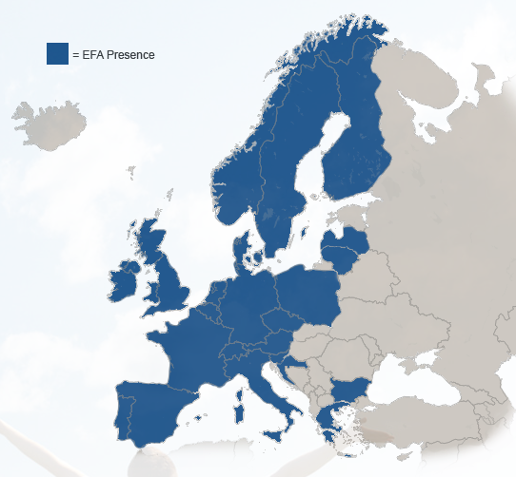
Who is EFA
The European Federation of Allergy and Airways Diseases Patients Associations (EFA) is a European network of:
38 patient organisations covering allergy, asthma and chronic obstructive pulmonary disease
in 24 European countries
representing 400,000 patients in Europe
EFA has its central office in Brussels, Belgium

Slide 3
EFA´s mission
EFA is dedicated to making Europe a place where people with allergy, asthma and COPD:
  have the right to the best quality of care and safe environment
  live uncompromised lives and
  are actively involved in all decisions influencing their health

Slide 4

Air Quality – EFA’s priority
We advocate to improve air quality because:
Clean air can avoid the onset of diseases and disease symptoms for asthma, allergy and COPD patients
Breathing is a prerequisite to life
Access to clean air is a human right
“I would like the air to be cleaner, to make breathing easier, and I would like children with asthma to grow up to have a future without the problem of environmental pollution”
[Soledad Alonso Mostaza, EFA Fighting for breath]

Slide 5
Vulnerable groups affected by air pollution
Air pollution affects everyone
but those who are more sensitive to air pollutants are more severely hit.
Vulnerable groups to air pollution include:
  Elderly
  Children
  Pregnant women
  Chronic disease patients:
    People with asthma suffer more with higher pollution levels
    COPD patients experience more exacerbations
    Air pollution causes hearth attacks and strokes in cardiovascular patients
    People living with diabetes affected by acute cardiovascular effects of pollution
87% of Europeans think respiratory diseases,
asthma and allergy
are a serious problem caused by air pollution
[Eurobarometer 2012]

Slide 6
Current communication on air pollution (EU legislation)
Lack of knowledge on air pollution risk increases vulnerability
7th Environment Action Programme objective
Ambient Air Quality Directive 2008/50/EC:
  Inform the public of the level of ground level air pollution, free of charge
  Information must be made available to the public, including trans-boundary air pollution
  Annex XVI, point 4 c), Public information on alerts and forecast should include:
    type of population, possible health effects and recommended behaviour:
    information on risk groups,
    description of likely symptoms,
    recommended precautions to be taken,
    where to find further information.

Slide 7
EFA principles to communicate risks on air pollution
Availability of information
is a step to increase knowledge
Suggested EFA principles when communicating risks to vulnerable groups and the general public are:
  Transparency
  Accessibility
  Tailored messages

Slide 8
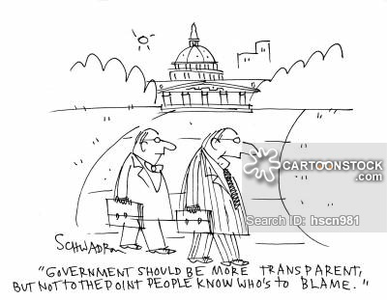
Communication principles: transparency
Available
≠
Transparent

Slide 9
Communication principles: transparency
Available ≠ transparent
Right to information is ensured: «no level of air pollution is safe» should be the starting point to reduce vulnerability
Accountability is promoted: share newest evidence, promote measures to improve air quality, respect legislations
There is a plan and it is at reach: define alert system, prevention/avoidance method, measurement of pollutants levels
Type of message is defined: frame messages, differentiate advice from warning

Slide 10
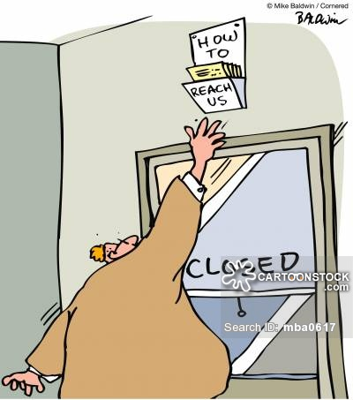
Communication principles: accessibility
Available
≠
Accessible

Slide 11
Communication principles: accessibility
Information is channeled: target user experience
Information is timely: reasonable time-frame to enable action
Feedback is allowed: enable input and access to more information
Coherence between public services: all refer to the same information
3 out of 5 Europeans
do not feel informed about air quality and policies in the EU [Eurobarometer 2012]

Slide 12
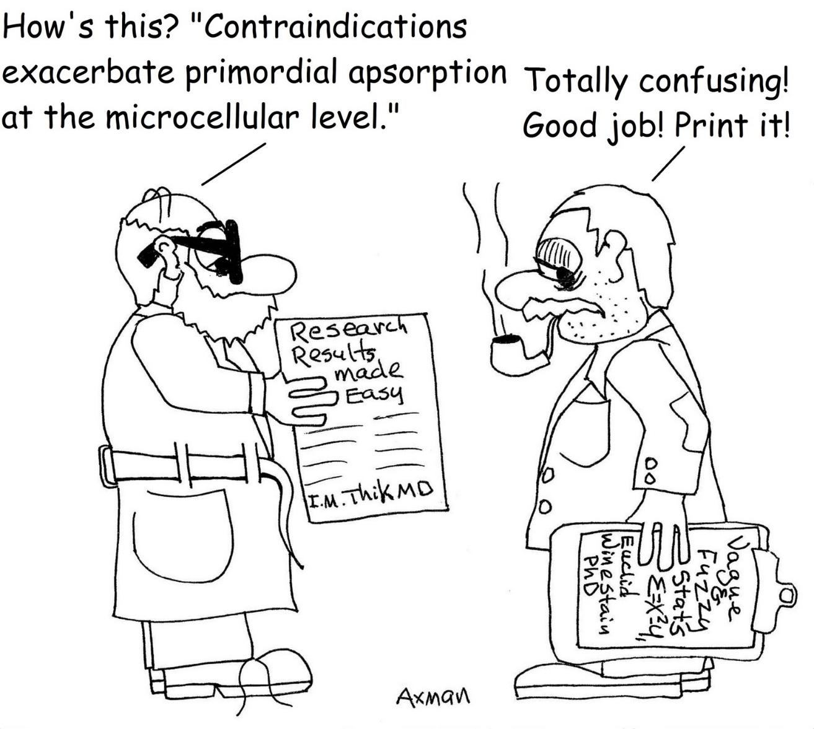
Communication principles: tailored messages
Available
≠
Tailored
(understandable)

Slide 13
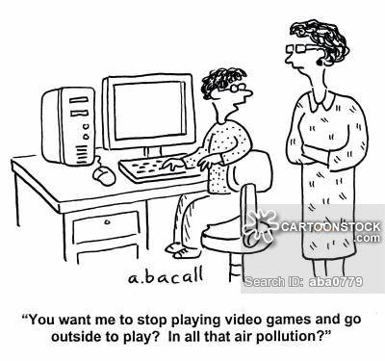
Communication principles: tailored messages
  Information is clear: simple and practical
  Messages give options: call to action for behavioral change and actions
  Information respond to the specificities of the group: adapted to scope, lifestyle, disease

Slide 14
EFA’s communication on
air pollution risks

Slide 15
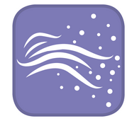
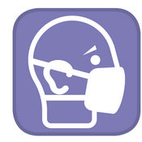

How is EFA communicating air pollution risks to health and actions?
Internal communications:
  NEW! Health determinants Working Group
External communications:
  Priority theme in new website
  Public advocacy (letters, campaigns)
  Social media (editorial agenda on air quality)
  Dedicated website with HEAL http://www.knowyourairforhealth.eu/

Slide 16
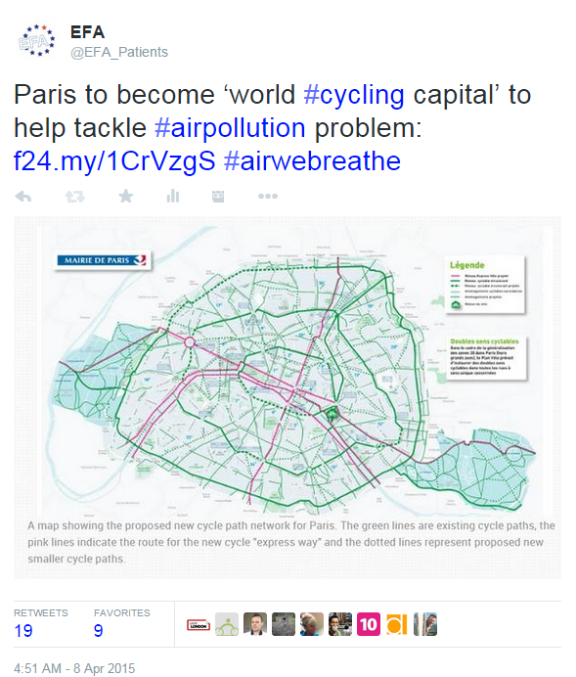


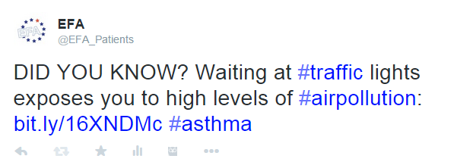
How is EFA communicating air pollution risks to health?

Slide 17
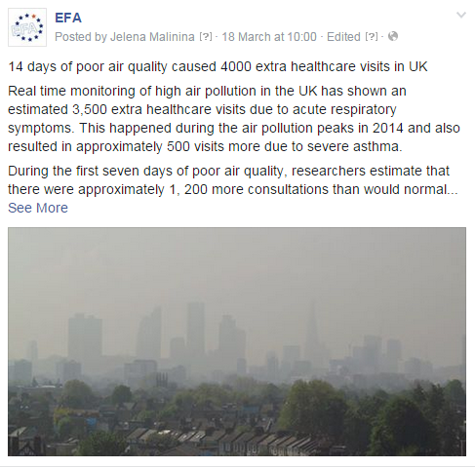

How is EFA communicating air pollution risks to health?

Slide 18
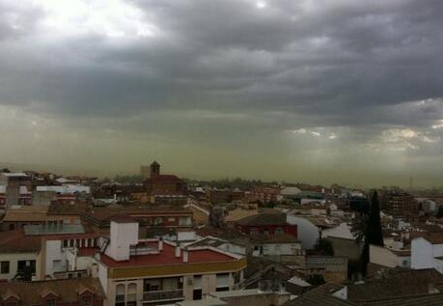
EFA example:
Advocacy on pollen monitoring
  Pollen deteriorates air quality levels
  Pollen worsens the conditions of people with allergic rhinitis
  Pollen concentrations are influenced by human activities
  Difference between pollutants emissions and pollen levels
  At EFA we ask for:
  need to secure real-time pollen information
  Include pollen information during the spring season on air quality updates
  Specific pollen-related advice for people with allergy during peaks
Pollen cloud in Jaén (Spain), May 2014

Slide 19
EFA Members communication on
air pollution risks:
Ireland
Poland
The Netherlands
United Kingdom

Slide 20
Asthma Society of Ireland: Smoky Coal campaign
  Transparent:
    survey and desk review
    ban on the sale and burning of smoky coal
  Accessible:
    Campaign newsletter and website news
    Specific advice phone line with nurses
  Tailored messages: 1500 people died on the Titanic
  1700 preventable deaths from air pollution
  BEST PRACTICE because:
  Accurate and certain information on risks
  Campaign voices the general opinion unanimously
  Scaled up from local to national

Slide 21

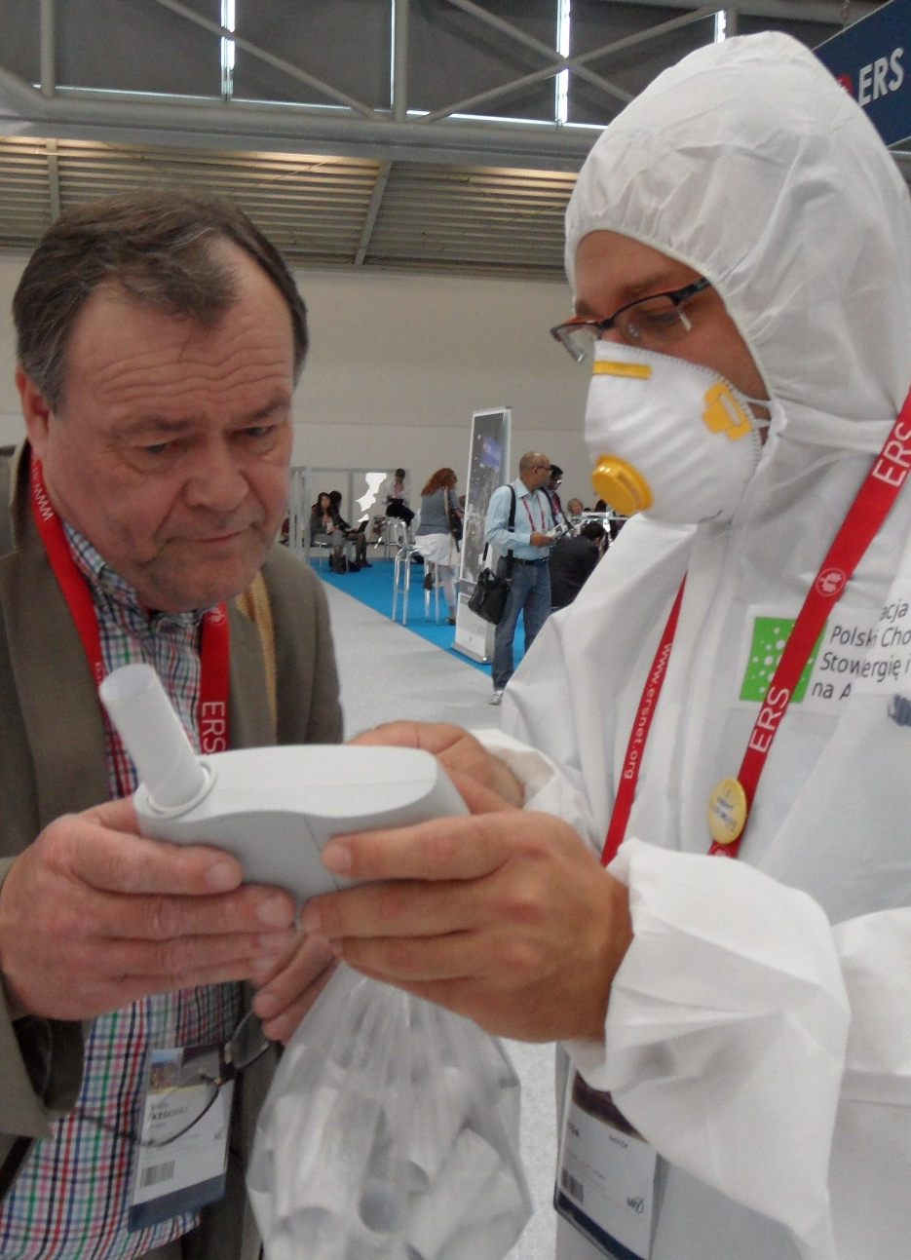
Polish asthma, allergy, COPD patients’ association:
Annual spirometry days
  Transparent:
    Based on published scientific work
    Yearly campaigns to recruit voluntary spirometry centers
  Accessible:
    National day and open doors activity
    Test results given to the patient
  Tailored messages:
    Emphasis on industrial sites
    Questionnaire prior to spirometry
    Discussions on air pollution effects on non-smokers
BEST PRACTICE because:
  Action axed on scientific research
  More successful than asthma and COPD days
  Direct link to air pollution effects on health

Slide 22

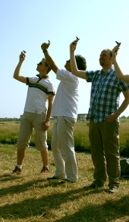
Longfonds: patients can measure air quality
  Transparent:
    2013 large-scale citizen science experiment
    iSPEX project led by university
  Accessible:
    Low-cost add-on for smartphone cameras
    Immediately shared (web platform, Twitter)
  Tailored messages:
    Everybody can use the technology
    Volunteers recruited among patients
    Fill in blind spots of measurement
  BEST PRACTICE because:
  Active citizen participation in air quality assessment
  Collective empowerment action, great media coverage
  Planning to organize more measurement days

Slide 23
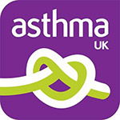
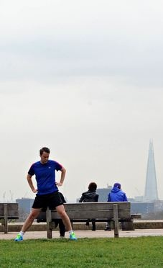
Asthma UK: targeting the general public
  Transparent:
    Based on UK official forecast, early information disclosure
    Everyday update and 120+ press articles
  Accessible:
    Channeled all info and resources across the comms. spectrum
    Helpline opened weekends
    Direct eye-impressions by patients
  Tailored messages:
    Partnered with other organisations to share tailored air pollution messages
    National and local scope
BEST PRACTICE because:
  Total reach in March-April campaigns 1.5 million people
  Unkown information on vulnerable groups, still getting media coverage

Slide 24
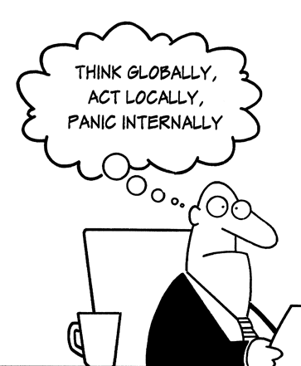
Conclusion
  Risk communication should target the empowerment of vulnerable groups against air pollution risks:
  Position information at the heart of a communication system on air pollution especially when risks become threats
  Make information relevant to vulnerable groups: they are actors of their own health and should be given options to tackle/cope with symptoms
  Involve and engage vulnerable groups: they can be part of the solution!
CHANGE THE SITUATION

Slide 25
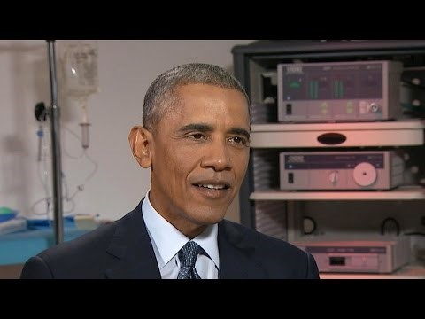
Annex
Obama interview to CBS News (8/04/2015)
« Climate change effects on public health »

Slide 26
Questions?
Thank you for your attention!
www.efanet.org
Isabel.proano@efanet.org
Twitter: EFA_Patients
Special thanks to EFA Members Pheena Keeny (IE),
Christine Strous (NL), Artur Badyda (PL), and Dr. Luke Tomlinson (UK) for their precious support preparing this presentation

