Slide 1
Seeking an IMI funding call in asthma
Erika Kennington, Asthma UK

Slide 2
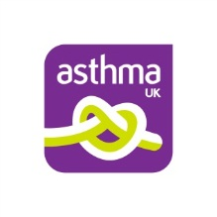
EARIP
Multidisciplinary partnership co-ordinated by Asthma UK
Aim: to agree asthma R&D priorities
€500,000 grant funded under the EU FP7 programme
12 partners from across Europe
50+ consortium members

Slide 3
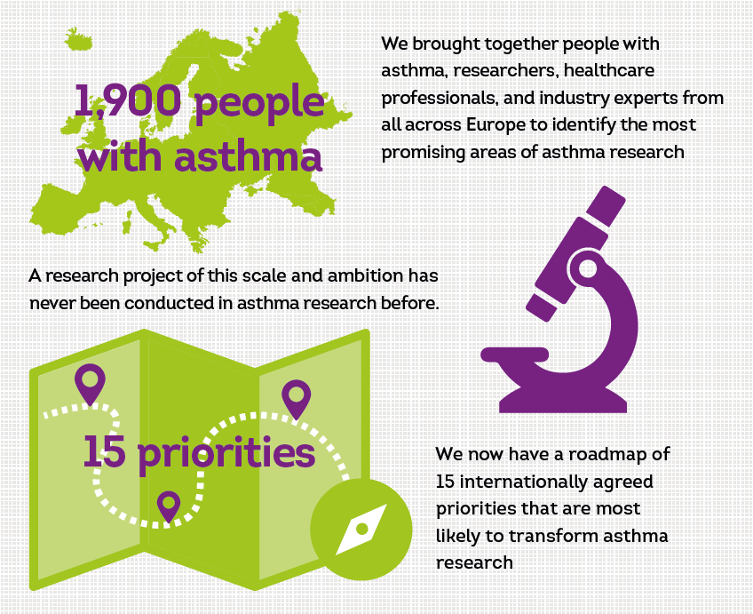
European Asthma Research & Innovation Partnership
Sarah Masefield, Jessica Edwards, Kjeld Hansen, Dominique Hamerlijnck, Karin Lisspers, Marc van der Schee, Liliana Silva, John Matthews, Mina Gaga, Ian Adcock, Stephen Holgate, Samantha Walker, Pippa Powell. European Respiratory Journal 2017 49: 1602295; DOI: 10.1183/13993003.02295-2016

Slide 4
Driving increased investment in asthma research
EARIP research priorities established in September 2016
Asthma UK set the target of achieving an IMI call to address asthma biomarkers/phenotypes (priority no. 1)
Identify, understand and better classify the different forms of asthma, their progression, and effect on airway inflammation and the immune system
Innovative Medicines Initiative (IMI) is a public-private partnership between the pharmaceutical industry and the European Commission
Through EFPIA companies decide on areas of research they want to invest in and then submit a proposal or proposals to IMI.
If IMI agree to co-fund a call, they then issue a call for applications and ask for organisations and companies to form consortia and develop applications for the funding.
An IMI call can have up to €50 million attached to it.

Slide 5
Asthma UK objectives and activities
Primary objective: A published IMI call in biomarkers and stratified medicine for severe asthma by the end of 2018.
Secondary objectives: Develop a comprehensive influencing plan by January 2017, and a European Parliament event by 2017.
Identifying stakeholder targets for influencing
Support EFPIA to develop the proposal
Influence the decision makers via individual meetings and via a roundtable at the European parliament
Communicate to researchers to encourage collaborations and consortia development across Europe

Slide 6
What happened?
A series of meetings with key decision makers in London and Brussels and early conference calls with the pharmaceutical leads.
We held high-level meetings at the American Thoracic Society (ATS) and European Respiratory Society (ERS) conferences in 2016 and 2017 and a stand-alone meeting at Asthma UK where senior global research and development (R&D) leads for GSK, AZ, Vectura, BI, Novartis, TEVA, Sanofi and Genentech discussed the proposals and the benefits and opportunities associated with a new IMI in relation to their relative treatment pipelines.
We achieved consensus around a proposal for an ambitious programme of research into severe non-eosinophilic asthma.
Ultimately, no company volunteered to lead the submission which meant it could not proceed

Slide 7
‘Non-T2’ asthma
EARIP (FP7) “In patients with predominant T2-low asthma, can understanding the pathophysiological mechanisms of asthma in the absence of T2 inflammation and identification of biomarkers to define non-T2 phenotypes and molecular endotypes help understand the patient group better (e.g. patient demographics, asthma control, QoL, lung function including bronchial hyperresponsiveness, and exacerbation profile)?”
U-BIOPRED : severe asthmatics are a heterogeneous patient group with frequent exacerbations and/or progressive airways obstruction despite high levels of therapy.
Development of new treatments for such patients is hampered by heterogeneity, lack of consensus on diagnostic criteria, difficulty in translating pre-clinical human and animal models to drug efficacy and absence of biomarkers that predict therapeutic efficacy
Current drug discovery attention has been focused on “T2” severe asthmatics.
Recently the “non-T2” asthma patients recognised as being both a significant proportion of the severe asthma population and also being amongst the most difficult to treat.

Slide 8
Learning and next steps
Increased our knowledge of IMIs and other European funding projects
Have built relationships with senior R&D leads within the pharmaceutical companies and have a better understanding of the different funding models available to us
Pharmaceutical organisations have their own internal funding and resourcing pressures and we need to understand them
Established clear agreement that the unmet need for new treatments for severe non-eosinophilic asthma still exists and needs addressing
Although no EFPIA partner was willing to lead on the call at the time, the work has been done allowing a company to take it up in the future
How can patient orgs across Europe help us to secure an IMI call in future?

