Slide 2
Personalised Medicine
Where are we in asthma and COPD?
Carlos Robalo Cordeiro
ERS Secretary General

Slide 3
What is personalised medicine?
“personalised medicine means providing the right care to the right person at the right moment”
Notes:
Personalised medicine: are we ready?
Renaud Louis, Nicolas Roche
European Respiratory Review Sep 2017, 26 (145) 170088; DOI: 10.1183/16000617.0088-2017
http://erj.ersjournals.com/content/50/4/1700391?utm_source=TrendMD&utm_medium=cpc&utm_campaign=_European_Respiratory_Journal_TrendMD_0
Although there are multiple definitions – with many arguing the term should be precision medicine!
What is precision medicine?
Inke R. König, Oliver Fuchs, Gesine Hansen, Erika von Mutius, Matthias V. Kopp
European Respiratory Journal Oct 2017, 50 (4) 1700391; DOI: 10.1183/13993003.00391-2017

Slide 4
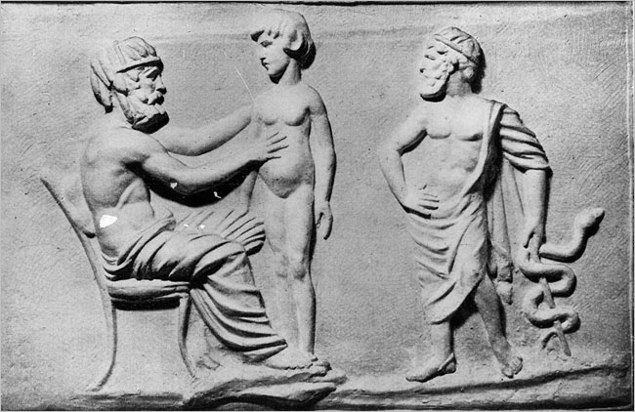
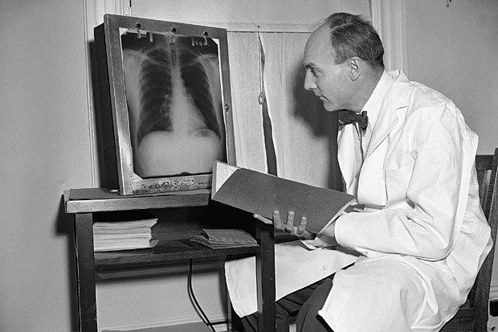
Is it really something new?
Medicine has been (fortunately) personalized for >3.000 years!
Notes:
Personalised medicine has been a fundamental principle in medicine since some humans began treating others [5]. But, although old in its principles, the concept is trapped in a never-ending modernisation process that sometimes makes it difficult to fully capture it [6]. Deciphering diseases has been a first step towards personalising care, aiming at answering the question “what is this patient suffering from?” This process began several centuries ago and is certainly not completed, as illustrated, for example, by debates surrounding the links, differences and overlaps between asthma and chronic obstructive pulmonary disease (COPD)
Personalised medicine: are we ready?
Renaud Louis, Nicolas Roche
European Respiratory Review Sep 2017, 26 (145) 170088; DOI: 10.1183/16000617.0088-2017
http://erj.ersjournals.com/content/50/4/1700391?utm_source=TrendMD&utm_medium=cpc&utm_campaign=_European_Respiratory_Journal_TrendMD_0

Slide 5
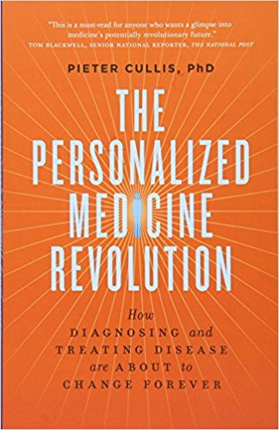
Notes:
However while it is not a new concept we are arguably witnessing a revolution in certain areas of medicine:
For example: researchers from the Wellcome Trust Sanger Institute announced they had determined that the most common and dangerous form of leukaemia is actually 11 distinct diseases that each respond very differently to treatment.
https://www.ft.com/content/4e825268-6432-11e6-8310-ecf0bddad227
In cancer therapeutics, the recognition that many cases of familial hereditary breast cancer can be attributed to mutations in the BRCA1 and BRCA2 genes was a valuable confirmation that certain subtypes of cancers could be clinically managed differently from others.^{[10,11]}
Since then, targeted therapies have been developed in order to treat other subsets of breast cancer (e.g., tamoxifen and trastuzumab),^{[12,13]} as well as other cancer types, including chronic myelogenous leukemia (imatinib), gastrointestinal stromal tumors (imatinib),^{[14]} metastatic melanoma (vemurafenib)^{[15]}
Each of these therapies relies on the molecular analysis of the tumour in order to place patients into more individualized treatment groups.

Slide 6
WHY?
Notes:
Why are we seeing this revolution?
The research factor:
In a nutshell:
1) There is an application of new technologies applied to well phenotyped
complex disease – ‘omics with appropriate informatics.
2) There is more understanding about the origins of disease and causative
pathways: More research will study well phenotyped population and disease cohorts.
Deep sequencing and rare genetic variants.
3) Improved methodology for capturing individual exposures
(environmental, microbial, diet, stress, pollutants/chemicals) and
how these are integrated into partial phenotypes (exposome).
4) More emphasis on the influence of environment on susceptibility genes
including pharmacogenomics, microbiome, pollutants and chemical
exposure, epigenetics and tissue/organ specificity across the life course.
5) Increasingly the above approaches are being used to identify novel biomarkers that can be
converted into diagnostic tests to stratify disease into pathway specific
endotypes and for directing treatments more precisely.
(Presentation of Stephen Holgate – Dublin Summit 2013)

Slide 7

Notes:
There is the celebrity factor

Slide 8
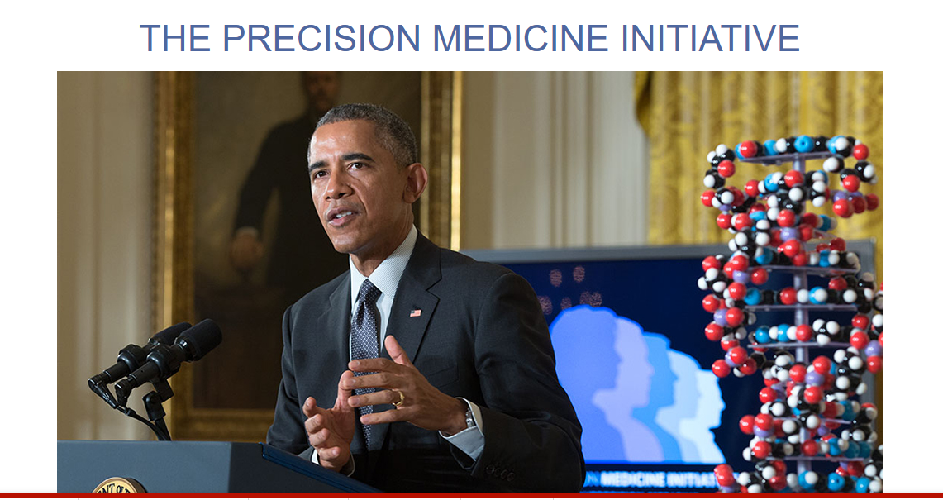
Notes:
There is the political factor

Slide 9
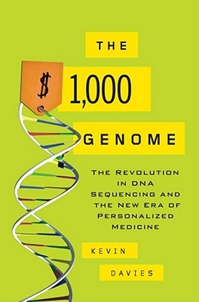
https://www.veritasgenetics.com/
In 2016, Massachusetts-based Veritas Genetics announced it had pushed the price of
sequencing a whole genome below $1,000 for the first time…
Notes:
There is the plummeting cost of complete genome sequencing.
One crucial reason for the shift towards personalised medicine is the rapidly falling cost of genetic testing. The first complete human genome sequence was published 15 years ago but the cost of analysing an individual’s DNA remained prohibitively expensive for years. Now that is changing. In 2016, Massachusetts-based Veritas Genetics announced it had pushed the price of sequencing a whole genome below $1,000 for the first time.
FT.com
https://www.ft.com/content/4e825268-6432-11e6-8310-ecf0bddad227

Slide 10
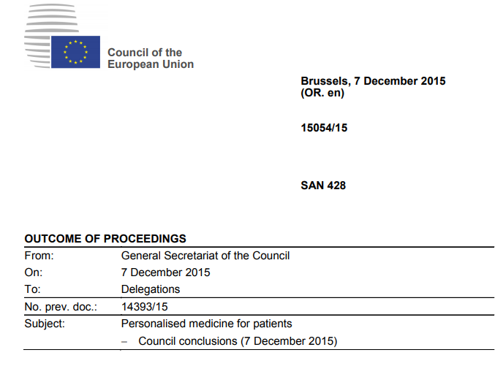
Notes:
There is increasing international co-operation
In their conclusions, the ministers invited the Member States to facilitate access to clinically effective and financially sustainable personalised medicine by developing patient-centred policies.

Slide 11
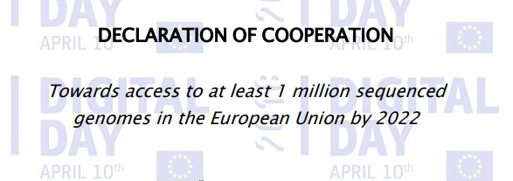
Notes:
With the most recent example – just last week:
Member States representatives co-signed a Joint Declaration indicating political support for linking existing and future genomic databanks, on a voluntary basis, in order to reach a cohort of one mil-lion sequenced genomes accessible in the EU by 2022.
16 Member States of the European Union have so far endorsed the political Declaration.
I am sure we will hear more from Denis Horgan later about this and the other EU initiatives on personalised medicine

Slide 12
What about the Lung?

Slide 13
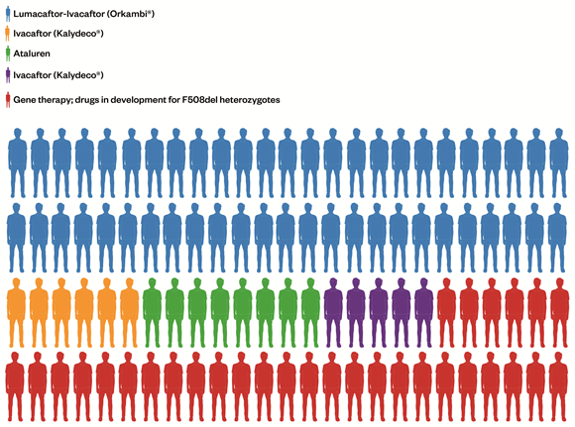
Notes:
‘Figure 1: Treating a population with precision medicines – what could that look like in the near future’ shows the proportion of the CF population in the UK who may derive benefit from each of the transformative therapies, either marketed or in development, based on class of mutation.
Cystic Fibrosis has also seen enormous advances. Gene therapy trials in CF continue to make progress (an account of which has recently been published in The Pharmaceutical Journal^{[35]}), drugs designed to restore CFTR function have risen in prominence in recent years, both in clinical and political spheres. To date, two drugs have reached market, with several others currently under investigation^{[36}
https://www.pharmaceutical-journal.com/research/review-article/conventional-therapies-and-emergent-precision-medicines-for-cystic-fibrosis-challenges-and-opportunities/20201932.article

Slide 14
What is ERS doing?
Notes:
A lot – many sessions on the topic of personalised medicine at congress, in research seminars, in education etc..

Slide 15
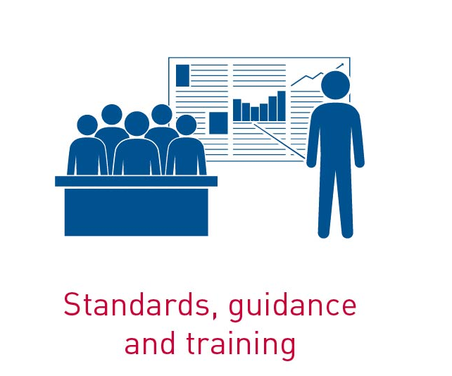



ERS Research agency
Facilitate respiratory research and to promote high-quality, multinational respiratory research.

Slide 16
Promote research at a pan-European level
ERS Clinical Research Collaborations Programme
SHARP
ARIANE-IPF
EMBARC
TBnet
Early-CAD
NEUROCOUGH
WEAN SAFE
GLI
EARCO
SPACE
INCIRCLE
PEX-NET
ESADA
ToXcsin
ChILDEU
ICE
Notes:
CRC2013-02 International Collaboration to Improve Respiratory Health in Children (INCIRCLE) Peter Sly Zoltan Hantos
CRC2013-06 The European Multicentre Bronchiesctasis audit and Research Collaboration (EMBARC) James Chalmers Eva Polverino
CRC2014-02 European Sleep Apnoea Database (ESADA) Jan Hedner Walter McNicholas
CRC2014-03 Tuberculosis Network European Trialsgroup (TBNET) Christoph Lange Graham Bothamley
CRC2015-01 ERS pan-European IPF registry and biobank (ARIANE-IPF) Vincent Cottin Bruno Crestani
CRC2015-02 The European Research Collaboration for Children's Interstitial Lung Disease (ChILDEU) Steve Cunningham
CRC2015-04 The Global Lung Function Initiative (GLI) Network Sanja Stanojevic Graham L Hall
CRC2015-06 RATIONAL - an ERS Research Network for Real Life Assessment of Targeted and Immunotherapies in Lung Cancer Care Thierry Berghmans Jacques Cadranel
CRC2015-07 Enhancing participation of asthmatic children in therapeutic trials of new biologics and receptor blockers (SPACE - Severe Pediatric Asthma Collaborative in Europe) Jonathan Grigg Franca Rusconi
CRC2016-04 Pulmonary Hemodynamics during Exercise - Research Network (PEX-NET) Horst Olschewski Philippe Herve
CRC2016-05 The International Collaborative Effusion (ICE) Database Nick Maskell Julius Janssen
CRC2016-08 SHARP: Severe Heterogenous Asthma Research collaboration, Patient-centered Ratko Djukanovic Elisabeth Bel
CRC2017-11 WEAN SAFE "John LaffeyLeo Heunks" Worldwide assessment of separation of patients from ventilator assistance (WEAN SAFE study)
CRC2017-07 NEUROCOUGH "Lorcan McGarveyLieven Dupont" "NEw Understanding in the tReatment Of COUGH (NEUROCOUGH) Clinical ResearchCollaboration: A pan-European multi-centre network to improve the management of Cough."
CRC2017-03 Early-CAD "Alvar Agusti Wisia Wedzicha" Lung function in Early Adulthood and Chronic Airway Diseases later in life (Early-CAD)
CRC2017-02 EARCO "Marc MiravitllesGabriel Thabut" European Alpha-1 Research Collaboration (EARCO)

Slide 17
Personalised medicine in Asthma
Research has led to great improvements in personalised clinical practice:
Mostly for severe eosinophilic asthma (a sub-type of asthma)
Biomarker: Simple blood cell count
Biologic therapies: anti-IgE and anti-IL5 therapies (treatments targeting two sub-types of asthma) which have driven the adaptation of precision medicine.
Notes:
So far it is without any doubt in severe eosinophilic asthma that personalised medicine has been the most successful.
In this regard, phenotyping based on high blood eosinophilic count has proved to be essential to predict good clinical response to anti-interleukin-5 (>300–500 eosinophils·µL⁻¹) and anti-IgE (>260 eosinophils·µL⁻¹), in asthmatics uncontrolled by moderate to high doses of inhaled corticosteroids (ICS) combined with long-acting β-agonists [20]. Therefore, the best biomarker to use biologics in severe T2 asthma is rather simple (blood cell count) and somewhat contrasts with the great deal of sophisticated research that has been needed to establish the role of IgE and interleukin-5 in severe asthma and to characterise T2 asthma
Personalised medicine: are we ready?
Renaud Louis, Nicolas Roche
European Respiratory Review Sep 2017, 26 (145) 170088; DOI: 10.1183/16000617.0088-2017
http://erj.ersjournals.com/content/50/4/1700391?utm_source=TrendMD&utm_medium=cpc&utm_campaign=_European_Respiratory_Journal_TrendMD_0

Slide 18
SHARP – Severe Asthma CRC - addressing key questions through large collaborations
Stakeholder board
National Center Leads Network
Patient Advisory Group
Industry partners
Scientific panel
Promotion & Dissemination
Discussion with Regulatory Agencies
Fundraising
Registry integration platform
Collaborative Analysis
Catalogue of Existing registries

Slide 19
SHARP – patient-centred research collaboration
Focus around patients needs for improvement of care and quality of life
Engagement of patient representatives at every level
  Steering committee led by 2 academics and 2 patients
  Patient Advisory Group (including EFA representative)
  Active participation to set-up the research agenda to prioritize what have the greatest impact on patients.
Patients seen as equal partners
Commitment of all project partners to keep patient needs central
Results shared with patients through ELF

Slide 20

Of course personalised medicine in asthma should not be restricted to the severe spectrum of the disease and it is really time to also apply the principle to patients with mild to moderate disease.
But to get to this stage we will need more research especially more clinical trials.
For example trialling whether inhaled corticosteroids are useful or not in non-eosinophilic asthma
Notes:
As an example:
“there is compelling evidence showing that non-eosinophilic asthmatics, defined as those having <2–3% eosinophils in their sputum cell count, respond poorly to ICS [2]. Yet guidelines still recommend starting with ICS in all asthmatics with persistent symptoms, irrespective of their inflammatory status,
We need large prospective long-term trials to clarify whether ICS are useful or not in non-eosinophilic asthma. If the answer were to be that ICS are useless (or even detrimental), this should lead to a revision of guidelines that could potentially bring cost savings by sparing unnecessary prescription.
Personalised medicine is not only about stepping up treatment with costly drugs in difficult disease but might also be sparing long-term treatment with inefficient drugs in patients with mild to moderate disease”.
It could also help to improve patient quality of life by saving them from taking treatments which don’t benefit this group, but which may cause side effects.
Personalised medicine: are we ready?
Renaud Louis, Nicolas Roche
European Respiratory Review Sep 2017, 26 (145) 170088; DOI: 10.1183/16000617.0088-2017
http://erj.ersjournals.com/content/50/4/1700391?utm_source=TrendMD&utm_medium=cpc&utm_campaign=_European_Respiratory_Journal_TrendMD_0

Slide 21

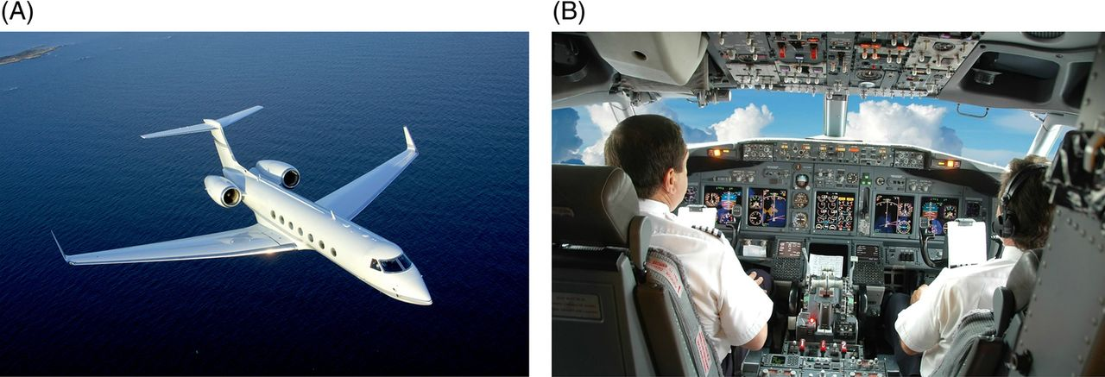
Thorax 68: 687-690, 2013

Slide 22
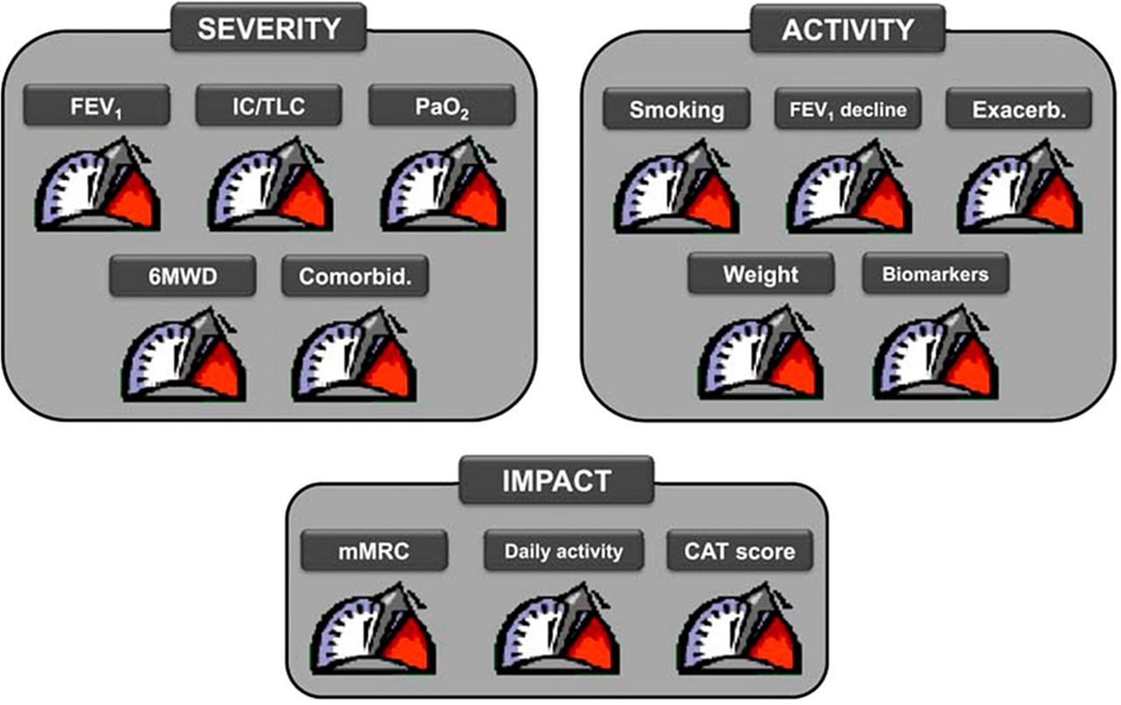

Chronic obstructive pulmonary disease control panel for personalised medicine in the clinic.
Alvar Agusti Thorax doi:10.1136/thoraxjnl-2014-205507
Copyright © BMJ Publishing Group Ltd & British Thoracic Society. All rights reserved.
Notes:
Chronic obstructive pulmonary disease control panel for personalised medicine in the clinic. Each of the three modules (severity, activity and impact) provides information on an actionable (ie, treatable) component of the disease. CAT, COPD Assessment Test; FEV₁, forced expiratory volume in 1 s; IC, inspiratory capacity; mMRC, modified Medical Research Council dyspnoea score; 6MWD, 6 min walk distance; Pao₂, arterial oxygen tension; TLC, total lung capacity. For further explanation, see text. Reproduced with permission from Agusti and MacNee.25

Slide 23
COPD
Agusti A. Thorax 2014
Notes:
Cartoon representation of complexity and potential alternatives for assessment and management of chronic obstructive pulmonary disease (COPD). Each node represents one theoretical patient and each colour represents one clinical characteristic. For further explanation, see text.

Slide 24
COPD
Phenotypes
Agusti A. Thorax 2014
Notes:
Pheno-/endotyping chronic obstructive pulmonary disease (COPD) is really important because it provides patients with precise and personalized medicine.[..] Ideally, we should search for genetic and molecular biomarker-based profiles.
Given the clinical complexity of COPD, it seems likely that a panel of several biomarkers will be required to characterize pathogenetic factors and their course over time. The need for biomarkers to guide the clinical care of individuals with COPD and to enhance the possibilities of success in drug development is clear and urgent, but biomarker development is tremendously challenging and expensive, and translation of research efforts to date has been largely ineffective.
Furthermore, the development of personalized treatments will require a much more detailed understanding of the clinical and biological heterogeneity of COPD. Therefore, we are still far from being able to apply precision medicine in COPD and the treatable traits and FEV₁-free approaches are attempts to precision medicine in COPD that must be considered still quite unsophisticated.
Cazzola, M., Calzetta, L., Rogliani, P. et al. Mol Diagn Ther (2017) 21: 345. https://doi.org/10.1007/s40291-017-0266-z
https://www.ncbi.nlm.nih.gov/pubmed/28247183

Slide 25




























COPD
Treatable Clinical Traits
Agusti A. Thorax 2014
Notes:
There has been some progress though and recent research […] on identifying markers that predict which patients will benefit from specific treatments such as ICS.¹¹ One such predictor is peripheral blood eosinophilia, a biomarker that has been the subject of important recent advances in the context of the effectiveness of ICS.
Precision Medicine Urgency
Suissa, Samy et al.
CHEST , Volume 152 , Issue 2 , 227 – 231
http://journal.chestnet.org/article/S0012-3692(17)31023-1/fulltext

Slide 26
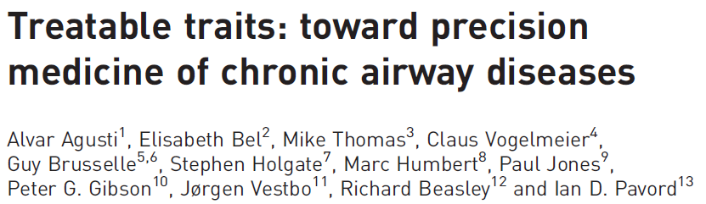

Slide 27
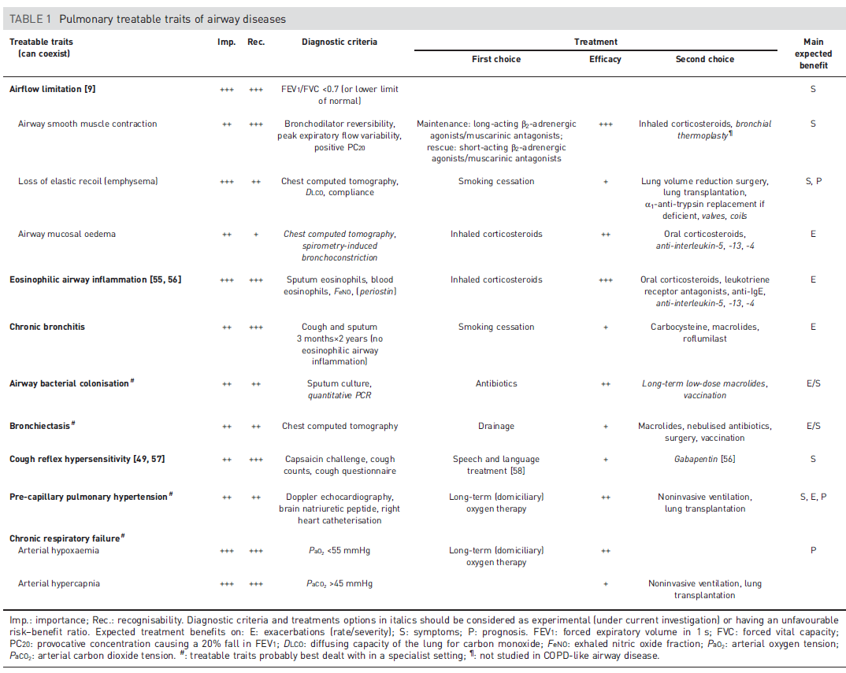

Slide 28
ERS Actions at EU level on Research

Slide 29
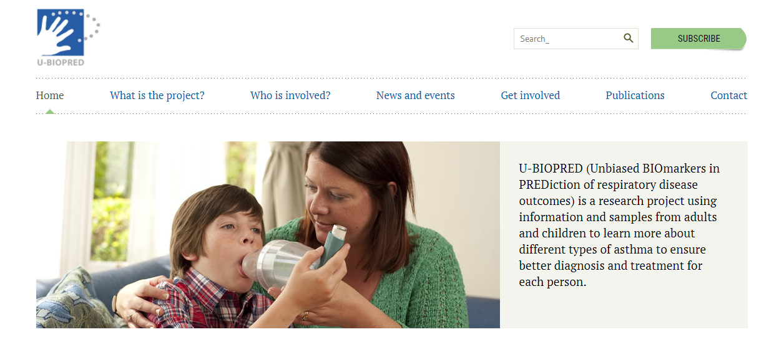
U-BIOPRED
Notes:
U-BIOPRED was a major EU IMI project which collected the biggest cohort of severe asthma patients and which helped to identify new sub-types of asthma. It integrated very well Patient organisations, including EFA, Longfonds and ELF as partners.

Slide 30

Notes:
Process of producing new research programme is long and this document is the first step by ERS.
Personalised medicine forms part of our key recommendations.

Slide 31




Slide 32






Slide 33





Notes:
We call for the:
Collection and integration multi-parameter molecular and biochemical measurements linked with clinical features, imaging and point of care detection from new and existing cohorts.
• Development and validation of clinically predictive models of disease including machine learning and a “virtual lung” models adressing different disease endotypes.
• Enabling implementation of personalised medicine in clinical practice - the right drug for the right patient at the right time.

Slide 34



Slide 35

Biomedical Alliance set up the Scientific Panel for Health which advocates for medical research including personalised medicine
Notes:
*The European Commission's Scientific Panel for Health (SPH) is a science-led expert group based on the provisions of the Horizon 2020 Specific Programme that has been tasked with helping to achieve better health and wellbeing for all.
https://ec.europa.eu/programmes/horizon2020/en/h2020-section/scientific-panel-health-sph

Slide 36

We are a partner organisation of EAPM

