Slide 1



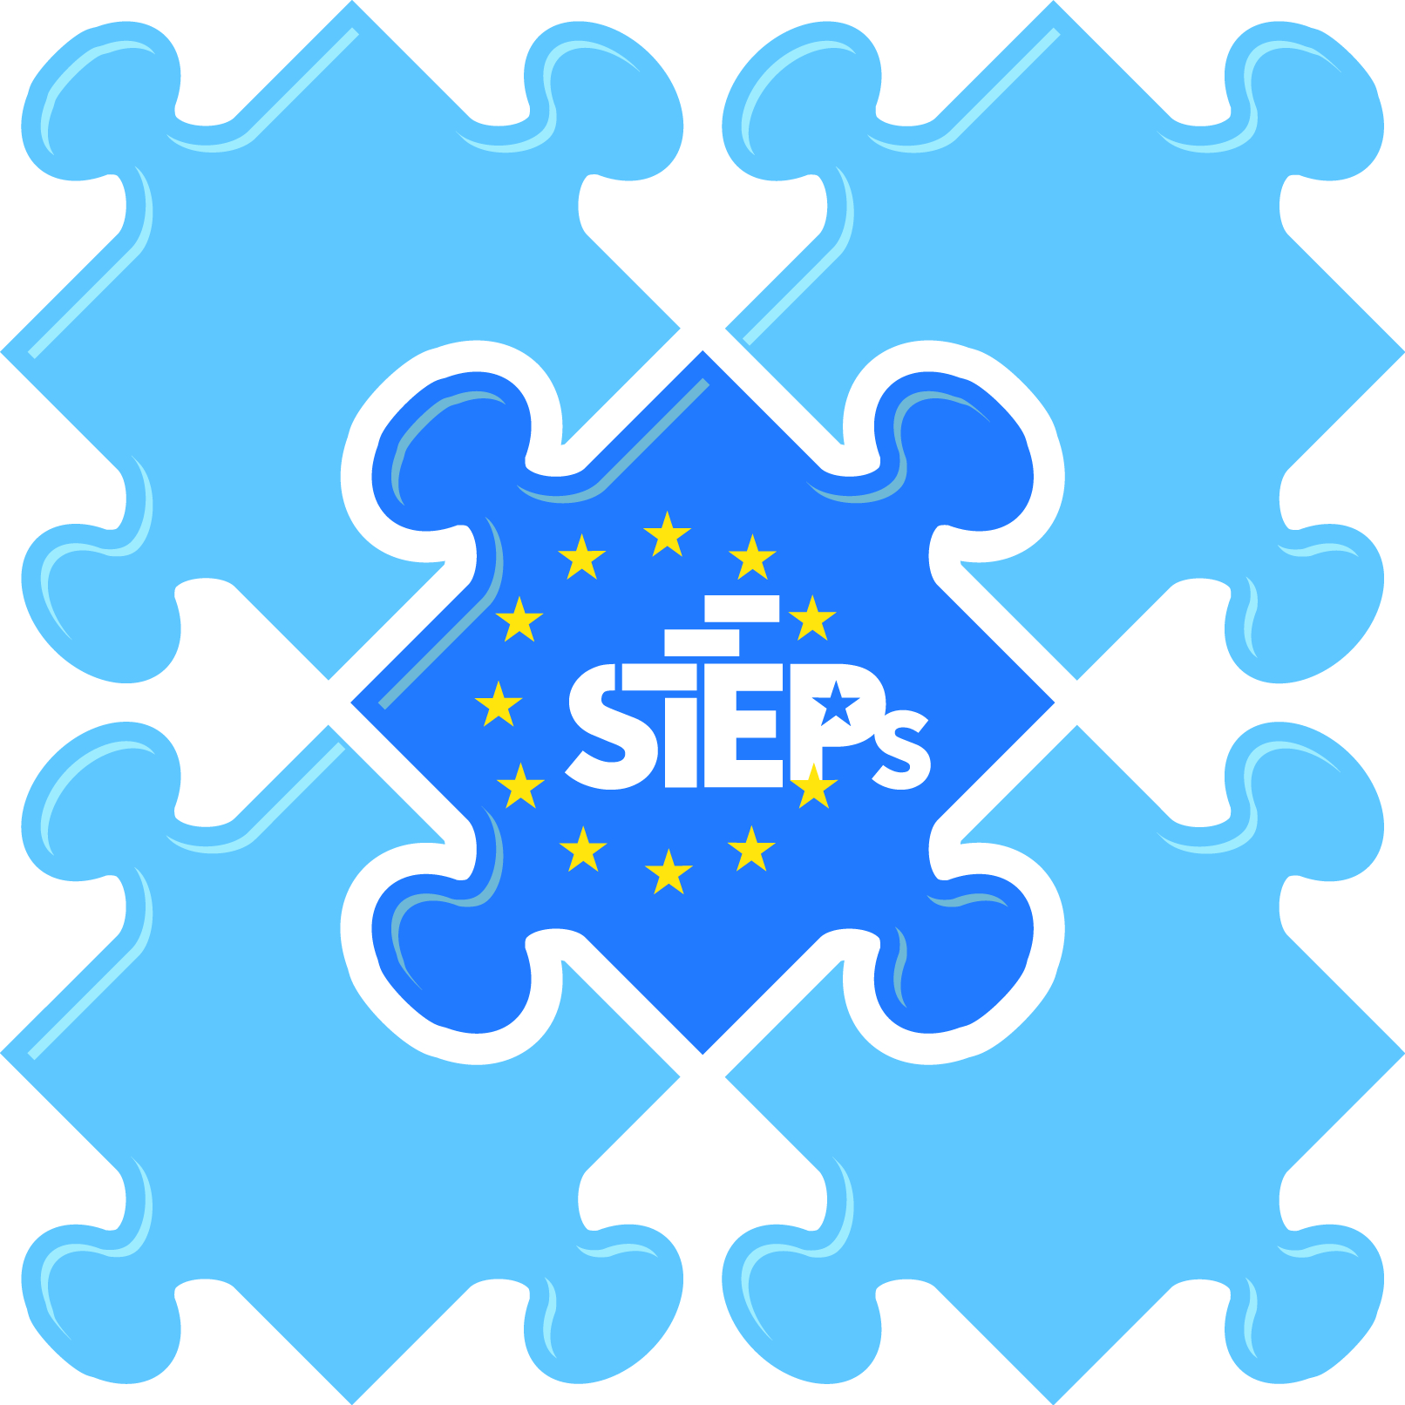

^{Medicine into the EU Strategy}
^{Brussels -} ^{09th & 10th September} ²⁰¹⁴
Policy and Practice progress – Working in One Front
Annual General and Patient Leaders Meetings Agenda European Federation of Allergy and Airways Diseases Patients’ Associations| Lisbon| April 16th |

Slide 2
What is Innovation ?
Innovation = translation of knowledge and insight to value
Value=
Value to patients
Value to Society
Return on Invetsment

Slide 3
The Translational Challenge
There is a wide research-to-market gap in Europe. The latest EU innovation scoreboard, published in June 2017, noted that although the innovation performance of the EU is improving, progress is too slow. Many of our global competitors are increasing their innovation performance at a faster pace, and performance gaps remain wide within the EU itself. Europe’s comparative advantages in education, research, broadband infrastructure and ICT training are not matched by venture capital investments and the number of SMEs introducing innovations, both of which are declining strongly.
Europe still faces harsh choices about whether it is actually going to do what it has so often discussed.
Extracts from Horgan et a, lBiomed Hub 2017;2(suppl 1):481130

Slide 4
BUT, healthcare systems …
Function nationally
Have national efficiency as their highest priority
Produce data in incompatible silos
Secondary use of data is subject to data protection laws

Slide 5
“Drug innovation has also transformed the treatment of grievous illnesses, such as cancer - where we have seen significant value delivered at societal and individual patient level, with the promise of more to come”
      Experts estimate that innovative cancer drugs introduced between 1975 and 1995 have:
        Increased the 1-year crude cancer survival rate from 69.4% to 76.1%, the 5-year rate from 45.5% to 51.3%, and the 10-year rate from 34.2% to 38.1%
        Accounted for ~ 50-60% of the increase in age-adjusted survival rates in the first 6 years after diagnosis
        Added > 1 year of life to patients diagnosed with cancer in 1995
        Increased the life expectancy of the entire U.S. population by 0.4 years (since lifetime risk of being diagnosed with cancer is ~ 40%)
        Recent research suggests the value to the patient of a life year saved in cancer is actually closer to ~$300K, well above the typical $30-75K QALY values used in health economics

Slide 6
Personalised Medicine
Science has evolved but health systems lag behind
Challenges for society with potential emergence of tiered health systems...

Slide 7
Massive variation in direct spend on cancer care across Europe: major differences in where money is spent

Slide 8
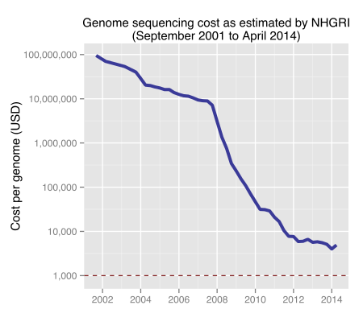
Rapidly falling cost of gene sequencing
Source: Ben Moore, from NHGRI data, quoted in Wikipedia:
https://en.wikipedia.org/wiki/Carlson_Curve#/media/

Slide 9

Interoperability of digital solutions: a challenge for Big Data

Slide 10
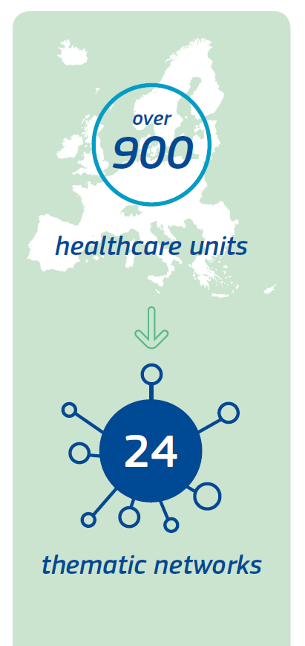
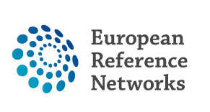
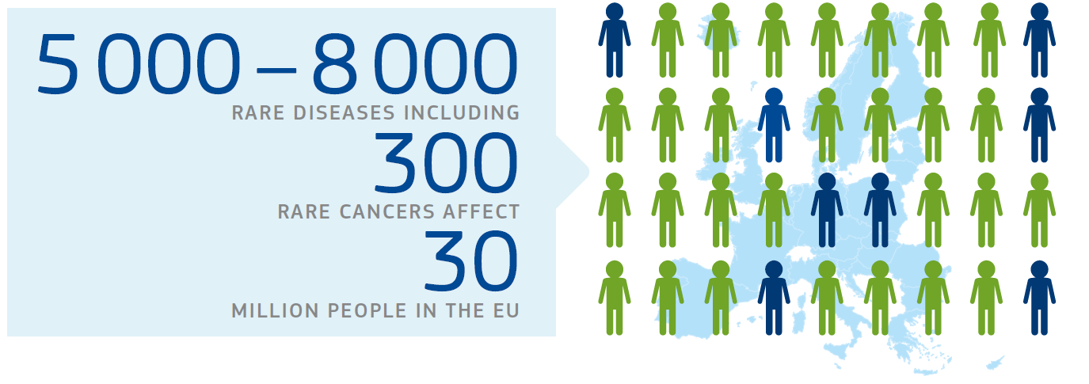
from 26 countries

Slide 11
Real world data in health care
Multiple sources of data:
Clinical databases (prescriptions, EHR, registries)
Clinical trials
Imaging data
'Omic data'
Published literature
Regulatory pharmacovigilance data
Social media/mHealth data

Slide 12
"Towards access to 1 million Genomes in the EU by 2022"
Joint Declaration indicating political support for linking* existing and future genomic databanks (on a voluntary basis) in order to reach a cohort of 1 million sequenced genomes accessible in theEU by 2022. This joint commitment will make it possible to:
Bring together fragmented infrastructure and expertise supporting a shared and tangible goal (1 million sequenced genomes accessible in the EU by 2022),
Leverage and maximise the investments already made by Member States at national and EU level, particularly in sequencing, biobanking and data infrastructure,
Reaching a larger cohort that will provide sufficient scale to inform the significance of "signals" identified in genomic and associated data, leading to new clinically impactful associations.

Slide 13
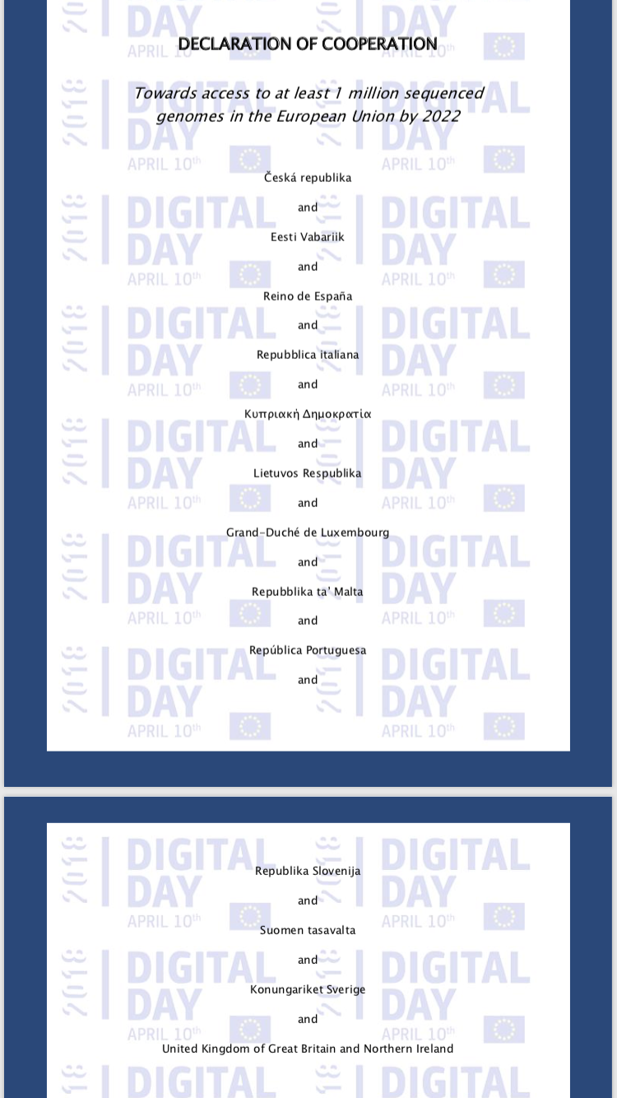
Member States signed – 16 Member States Signed
Italy
Croatia, Bulgaria, Lithuania
Czech Republic Luxembourg, ,
Estonia, Spain, Malta, Sweden, Slovenia, Greece, Cyprus, UK, Finland, Portugal

Slide 14
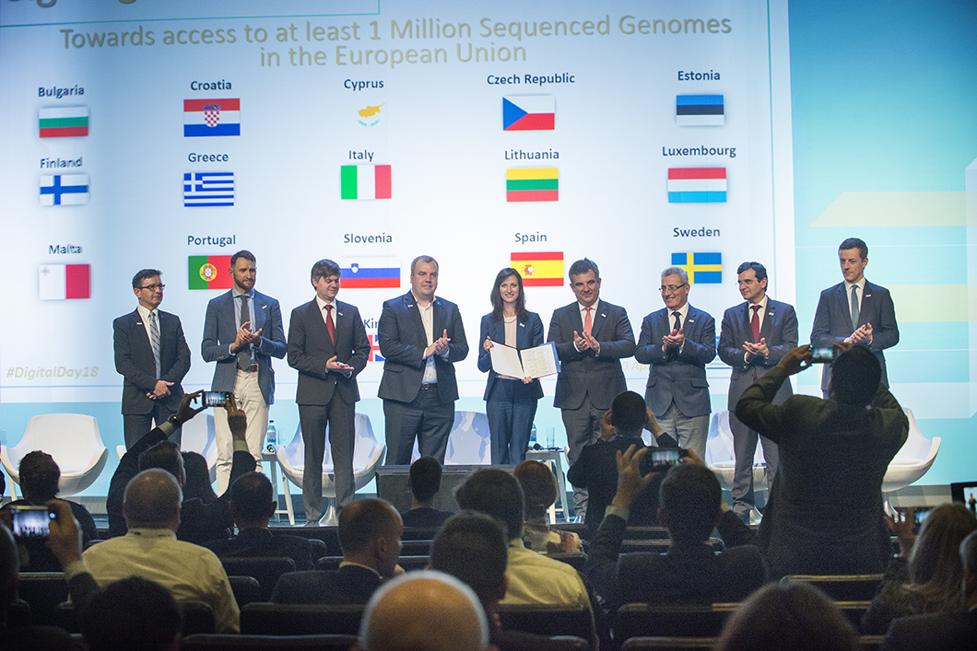
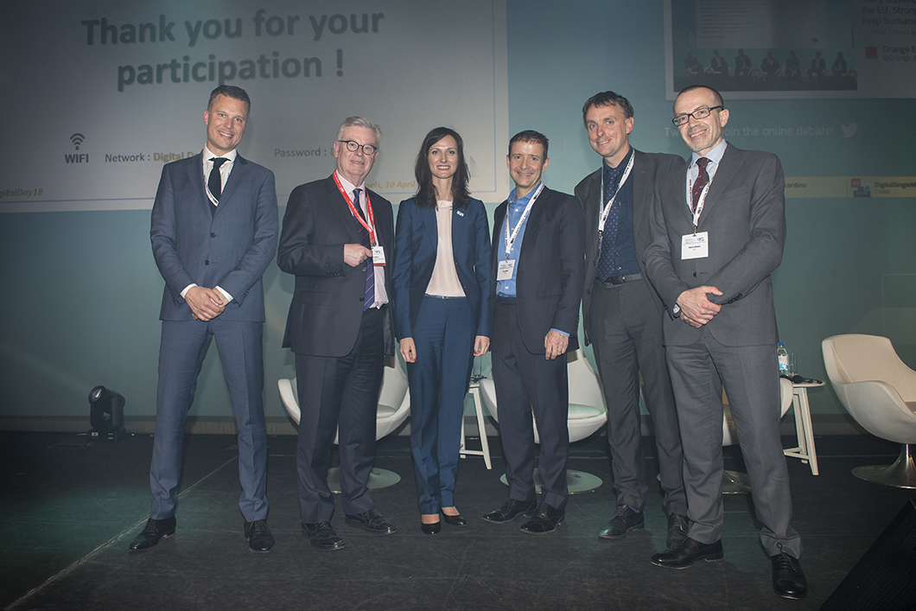

Slide 15
POLITICAL COMMITMENTS I
• Define a voluntary coordination mechanism of national, regional and local public authorities to link ongoing genomic medicine initiatives and to steer the activities stemming from this declaration;
• Ensure distributed, authorised and secure access to national and regional banks of genetic and other relevant data for the advancement of science and innovation, while taking appropriate measures to protect the privacy of individual data donors;

Slide 16
POLITICAL COMMITMENTS II
Access provided in a federated (not centralised) network to genomics data-sets at national / regional level.
• Define a governance model of cooperation, particularly concerning the terms and conditions for distributed access to genomic data across borders, usage of the data and other aspects deemed necessary by the signatories;
•

Slide 17
POLITICAL COMMITMENTS III
Support the development of technical specifications for secure access and cross-border exchange of genomic datasets and facilitate interoperability of relevant registries and databases to support research;
Develop a secure infrastructure and tools to enable cross-border sharing or analysis of genetic and other data-sets, anonymised as appropriate, from multiple Member States, building upon existing infrastructure;

Slide 18
POLITICAL COMMITMENTS IV
• Develop a coordinated data governance framework necessary to facilitate Europe-wide large-scale processing of health and related data in compliance with the applicable data protection legal framework, in order to support shared health policy goals; notably to achieve better health for citizens, future sustainability of health systems, and to boost large-scale data-driven biomedical and clinical R&D in Europe;

Slide 19
POLITICAL COMMITMENTS V
• Promote the use of open standards and data management systems to ensure interoperability of genomic and other health data with a view to enhance research on personalised medicine and genetic diseases;
• Strengthen cooperation on the implementation of the General Data Protection Regulation particularly as concerns the further processing of personal data concerning health.

Slide 20
Clarify the gap that needs to be closed by country and in relation to cross-country collaborative efforts by aligning the various stakeholders to facilitate delivery including relevant academic/research groups; commercial partners (large and small companies); clinical experts; patient groups; payers; and regulators.
To do this a series of Expert Committees will be established:
Committee 1. Clinical and Scientific
Committee 2. Ethical Legal and Social Implications
Committee 3: Education, Engagement and Communications
Committee 4: Data and Informatics
Committee 5: Sequencing

Slide 21
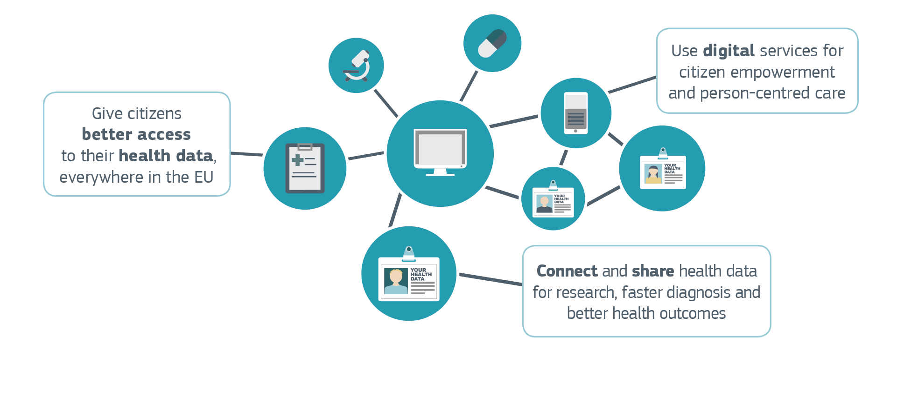
Communication on the Digital Transformation of Health and Care

Slide 22
Role of Innovation and Financing
As a result of rapid diffusion, governments have faced unprecedented challenges in balancing high quality and innovative care with other dual concerns.
  Managing health care budgets and scarce resources.
  Safeguarding basic principles of access, equity, and choice.
Consequently, governments are increasingly required to strategically manage scarce resources by investing in services that deliver the best value for investment.
To help meet this challenge, various Member States have developed HTA systems.
  Overall, HTA systems seek to ascertain the relative effects of technology on health, the availability and distribution of resources, and other aspects of the health system.
  Helps to identify both cost-effective and cost-ineffective technologies and health services.
HTA provides a range of stakeholders with evidence-based information for decision-making (e.g., reimbursement, pricing) and priority-setting.
  Serves as a bridge between science and decision-making.

Slide 23

Why an HTA initiative?
Background
More than 10 years of cooperation: projects, joint actions
ACHIEVEMENTS
LIMITATIONS
Trust between HTA bodies
Capacity building
Development of joint tools (e.g. EUnetHTA Core Model, POP EVIDENT databases)
Piloting joint work (e.g. early dialogues, joint assessments)
Low uptake of joint work ⇒ duplication of work
Differences in the procedural framework and administrative capacities of Member States
Differences in national methodologies
No sustainability of current cooperation model

Slide 24
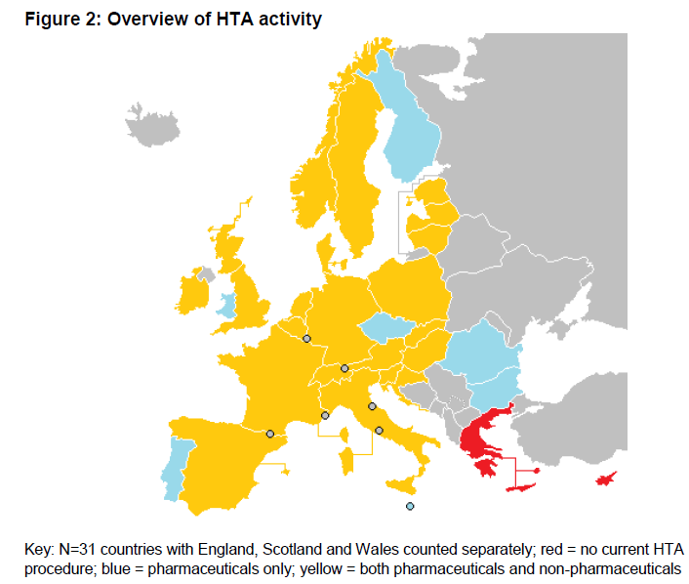
Background
HTA across EU
Differences in:
Procedural framework
Methodology
Scope
Medicinal products
→ 26 MS and NO
Medical devices
→ 21 MS* and NO
Under development
→ 2 MS
* In Wales HTA on medical devices
is under development
(EUnetHTA, WP7 report, 2017)

Slide 25
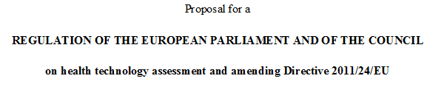
Article 1
The Regulation establishes:
  support framework and procedures for cooperation on health technology assessment at Union level
  common rules for clinical assessment of health technologies
The Regulation shall not affect the rights and obligations of Member States with regard to the organisation and delivery of health services and medical care and the allocation of resources assigned to them.

Slide 26

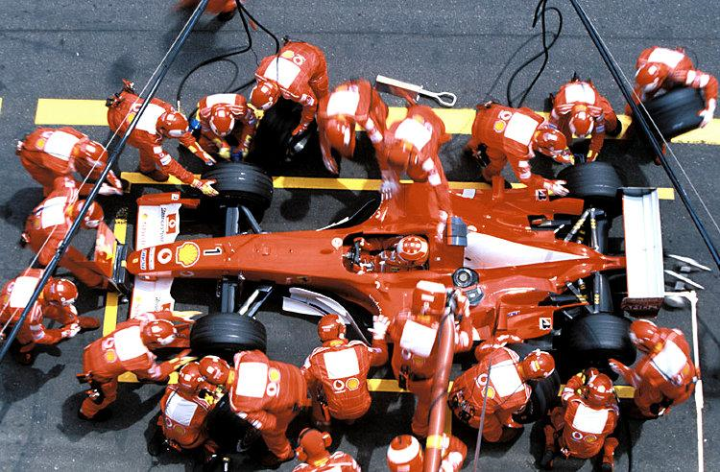
Cowboys and Pit crews*
The Project Culture:
Could the Health Care system be organized in a Matrix centered around
the patient and with a defined Project leader
* A. Gawande, the New Yorker, 2011
Page 26

Slide 27
